Slide 1




Connect 4: Robot Autonomous Player
Mid-Term Presentation
Boris Ivanov

Slide 2
Table Of Content

Slide 3
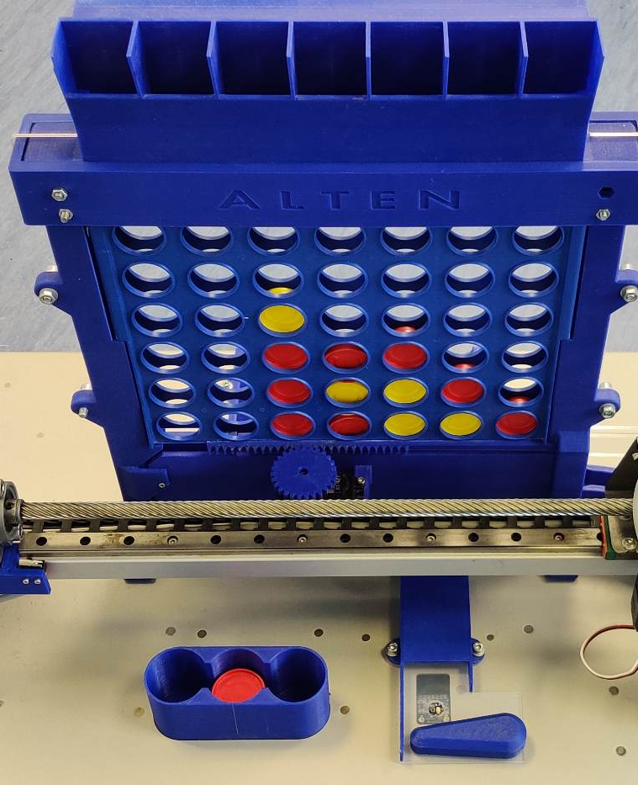
Introduction
Notes:
Good afternoon everyone, my name is Boris Ivanov and I'm delighted to be here today. I'm a 25-year-old electrical and electronic engineering student at Fontys, originally from the beautiful city of Varna, Bulgaria. Currently, I'm working on an exciting project called Connect-4 robot for ALTEN. It's a fascinating project that involves programming a robot to play the classic game Connect-4. As an engineer, I'm passionate about solving problems and creating solutions, and this project is a great opportunity for me to hone my skills. I look forward to sharing more about my work with you all.
[BRIEF INTRODUCTION OF THE GAME RULES]

Slide 4
ALTEN
ALTEN is a global technology consulting and engineering firm .
As a consultancy, ALTEN works with a wide variety of clients allowing their consultants to work on an area of engineering where their knowledge would be best applied.
Their expertise within the Netherlands lies in ALTEN IT, Technical Software, and Mechatronics and others.
Notes:
ALTEN provides research projects for technical and information systems divisions in various sectors, such as industrial, telecommunications, and service.

Slide 5
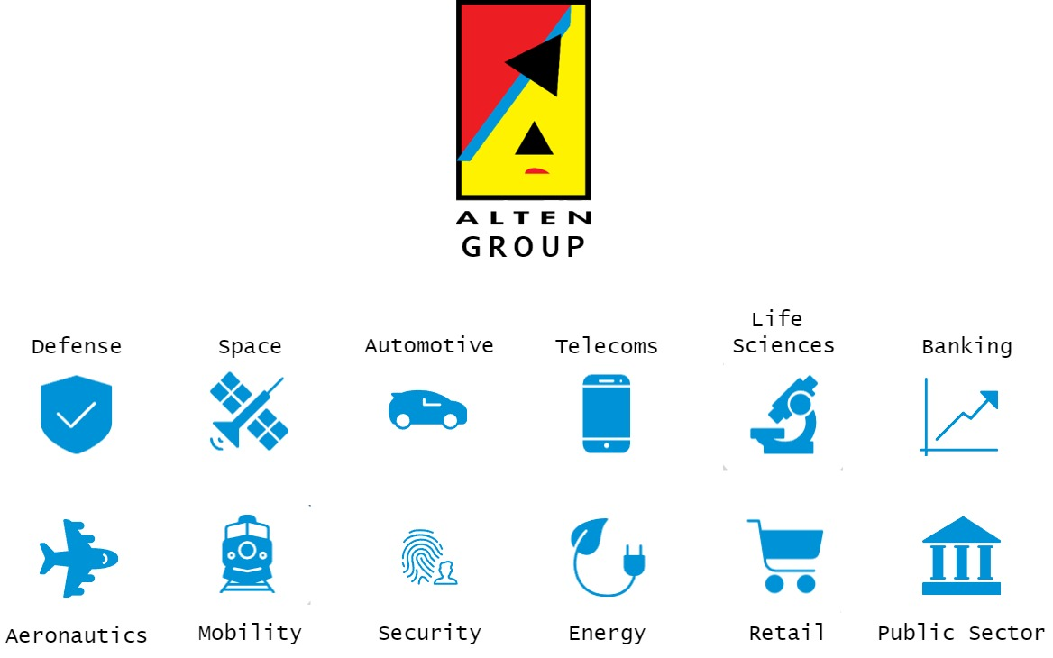

Slide 6
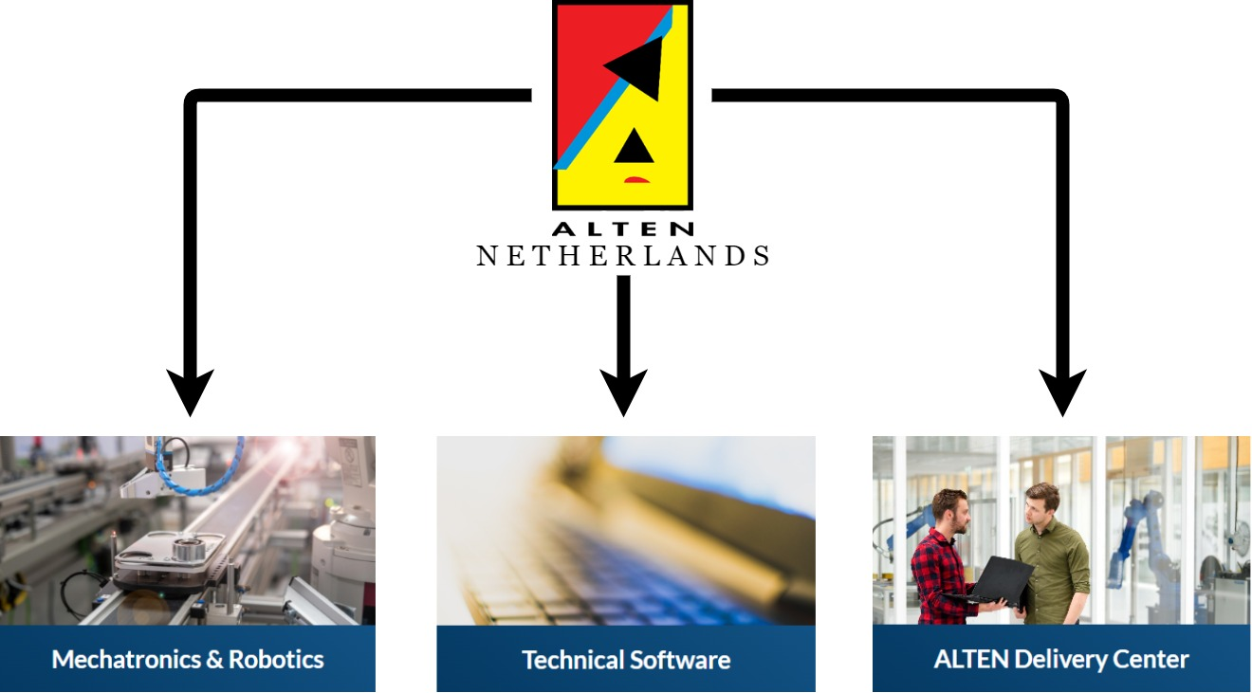
Notes:
Technical software focuses on embedded systems, simulation & modelling, monitoring & control, and business critical systems. This includes anything from banking systems to traffic light control.
ALTEN's mechatronics services include designing and prototyping complex systems, simulation and modelling, control systems development, system integration, and testing and validation.
The connect-4 robot falls somewhere in between TS and MTR.

Slide 7
The Connect 4 Machine - Operation
The Connect 4 Robot has a microcontroller that has two cores working together.
To ensure smooth operation, the two cores synchronize their actions using a synchronization primitive called Hardware Semaphore (HSEM).
The Cortex-M7 controls the higher-level logic and Cortex-M4
Cortex-M4 controls all the low-level logic.
Like movement of motors and sensors.
Notes:
1. the Cortex-M4 controls motors and sensors, while the Cortex-M7 manages game strategy and player communication.
The robot is designed to provide a fun and challenging experience for players while showcasing the potential of robotics and microcontroller technology in interactive applications.
The reasoning for the design of the machine being, to have something that can be used to show ALTEN’s expertise to showroom floors, open days and such events.
2. Slide
At the heart of the Connect 4 Robot is a microcontroller (small computer), with two cores. They are working together to control the robot's movements and game logic. One core, called the Cortex-M4, is responsible for managing the robot's motors and sensors, while the other, the Cortex-M7, handles higher-level tasks like game strategy and communication with the human player.
HSEMs help prevent conflicts and ensure that the microcontrollers share information effectively.

Slide 8

The Connect 4 Machine - Intention
8
The robot is designed to provide a fun experience for players, while showcasing the potential of robotics and technology in interactive applications.
The machine's design aims to display ALTEN's expertise at events like showroom floors and open days.
Notes:
1. the Cortex-M4 controls motors and sensors, while the Cortex-M7 manages game strategy and player communication.
2. Slide
At the heart of the Connect 4 Robot is a microcontroller (small computer), with two cores. They are working together to control the robot's movements and game logic. One core, called the Cortex-M4, is responsible for managing the robot's motors and sensors, while the other, the Cortex-M7, handles higher-level tasks like game strategy and communication with the human player.
HSEMs help prevent conflicts and ensure that the microcontrollers share information effectively.

Slide 9
The Initial State of the Project
9
Before my involvement, the system had all the hardware components in place and a software design that worked on the single-core implementation from several years ago.
1
2
3
4
5
Notes:
After further development of the old system, it was clear that a more powerful controller was needed to facilitate the new additions that ALTEN wanted to add to the system.
A dual-core microcontroller, which can handle the requirements of the system. (Integrate game_decision in CM7, LCD screen, Cloud/Ethernet)

Slide 10
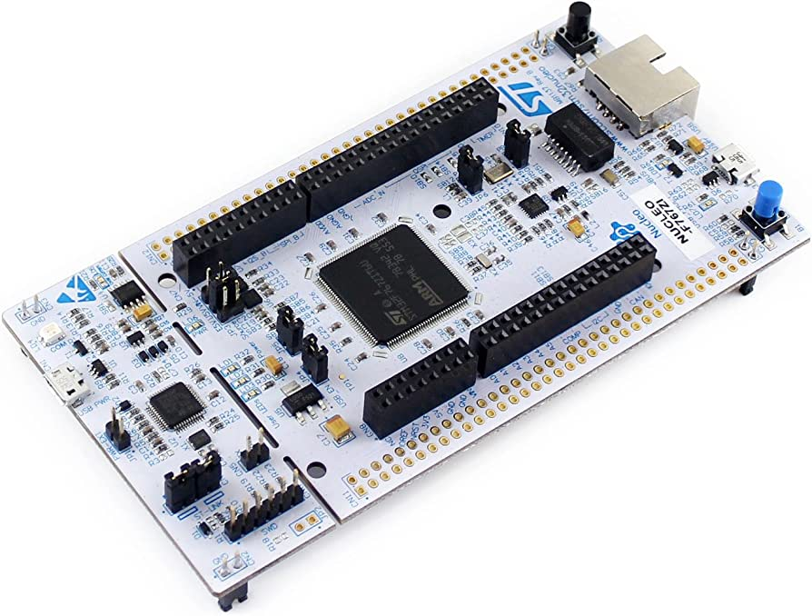
The Initial State of the Project
10
1
2
3
4
5
A new controller was chosen in the face of STM32H755.
Notes:
After further development of the old system, it was clear that a more powerful controller was needed to facilitate the new additions that ALTEN wanted to add to the system.
A dual-core microcontroller, which can handle the requirements of the system. (Integrate game_decision in CM7, LCD screen, Cloud/Ethernet)

Slide 11
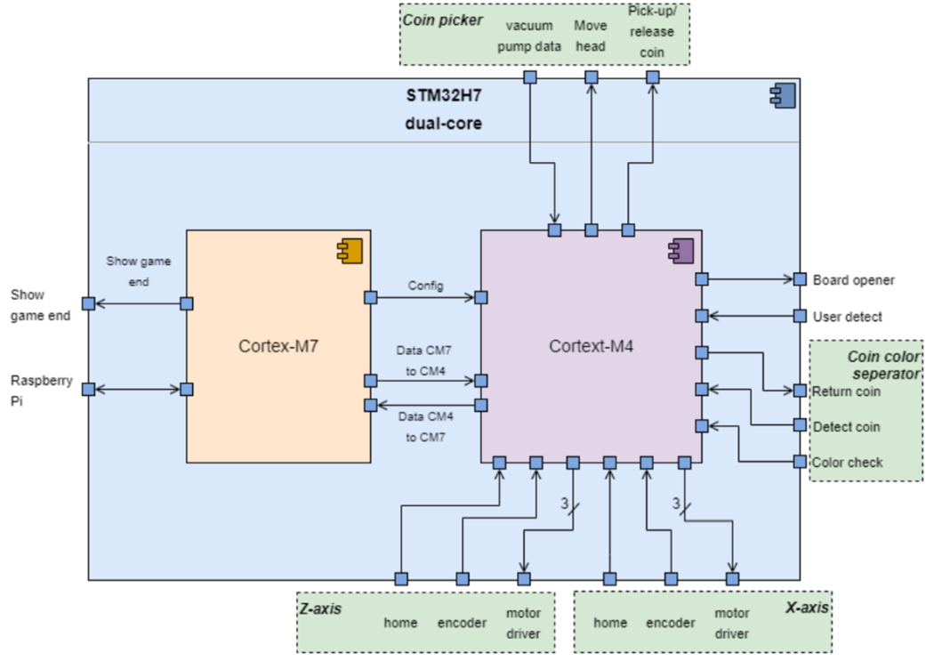
The Initial State of the Project
11
1
2
3
4
5
A new software architecture was designed
Notes:
After further development of the old system, it was clear that a more powerful controller was needed to facilitate the new additions that ALTEN wanted to add to the system.
A dual-core microcontroller, which can handle the requirements of the system. (Integrate game_decision in CM7, LCD screen, Cloud/Ethernet)

Slide 12
The Initial State of the Project
12
1
2
3
4
5
Notes:
After further development of the old system, it was clear that a more powerful controller was needed to facilitate the new additions that ALTEN wanted to add to the system.
A dual-core microcontroller, which can handle the requirements of the system. (Integrate game_decision in CM7, LCD screen, Cloud/Ethernet)

Slide 13
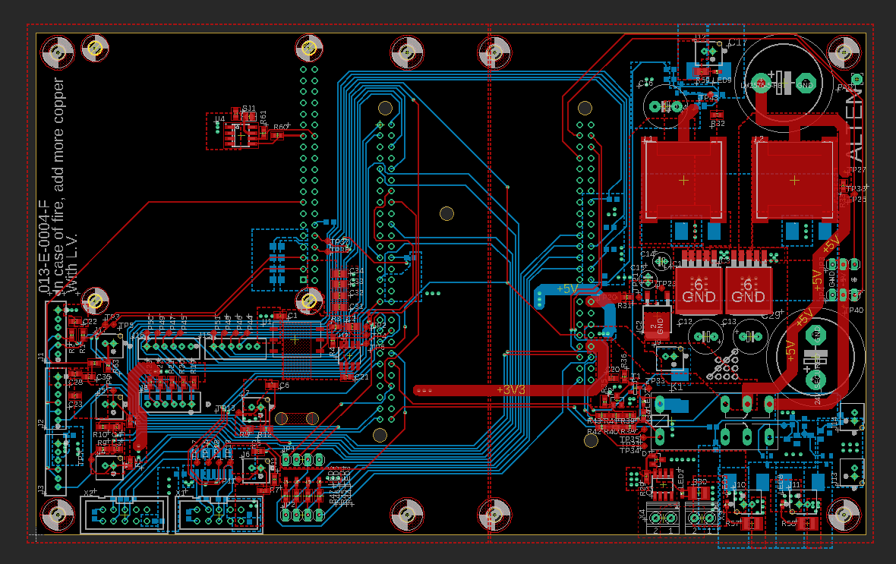
The Initial State of the Project
13
1
2
3
4
5
A new PCB to facilitate the new controller was also designed
Notes:
After further development of the old system, it was clear that a more powerful controller was needed to facilitate the new additions that ALTEN wanted to add to the system.
A dual-core microcontroller, which can handle the requirements of the system. (Integrate game_decision in CM7, LCD screen, Cloud/Ethernet)

Slide 14
The Initial State of the Project
14
1
2
3
4
5
Both previous designs included some SW but only for demonstration purposes.
Notes:
After further development of the old system, it was clear that a more powerful controller was needed to facilitate the new additions that ALTEN wanted to add to the system.
A dual-core microcontroller, which can handle the requirements of the system. (Integrate game_decision in CM7, LCD screen, Cloud/Ethernet)

Slide 15
My task
15
The legacy code needs to be adapted and optimized for the new microcontroller.
Further development of the state machines that control the logic of the cores.
Set up the software so it adheres to the new architecture.
Evaluate the architecture and software code designed so far.

Slide 16
Research
16
How to evaluate the system
What to test
How to test it
Improve the FSM of the Game Controller and Task Manager
HSEM
Mapping legacy code to new architecture
Notes:
Unit tests for the lowest level peripherals – Such as TIMers, NVIC_NestedVectorInterrupt, UART, I2C, ETH. Necessary in order to build confidence that the lowest level of hardware is functioning correctly.
Functionality tests, that provide confidence in the lowest blocks (one from level 3 in the architecture).
Then functionality tests about level 2 and level 1 were made. A lot of the overlap in criteria they test, however for a thorough and complete testing each level has to pass these test, so it can be ensured that everything on all levels of the architecture behaves as expected. That baseline of expectations has to be set somewhere, and the test created are precisely that.

Slide 17
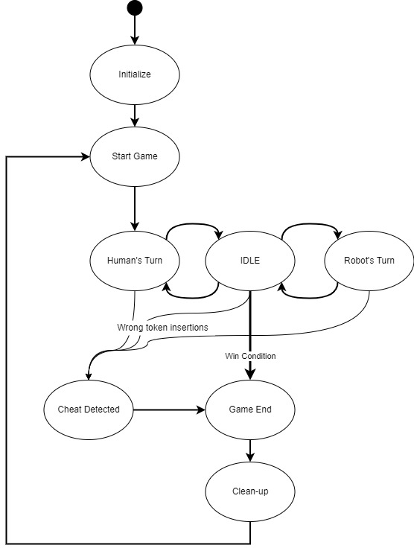
Combined overview of the higher-logic of the system

Slide 18
What is ahead of me ?
Continue merging the different projects together into a unified version.
01
Figure out how to merge the STM32F code to the STM32H.
02
Design the new modules from the new Software Architecture.
03
Test and validate the various designs.
04
Notes:
If enough time is left, I would like to conduct a happy-path test. Which is the test of the system as one intends for it to be used. And through that think of possible ways that the user can mess with the system.

Slide 19

Thank you for your attention!
Questions ?

Slide 20
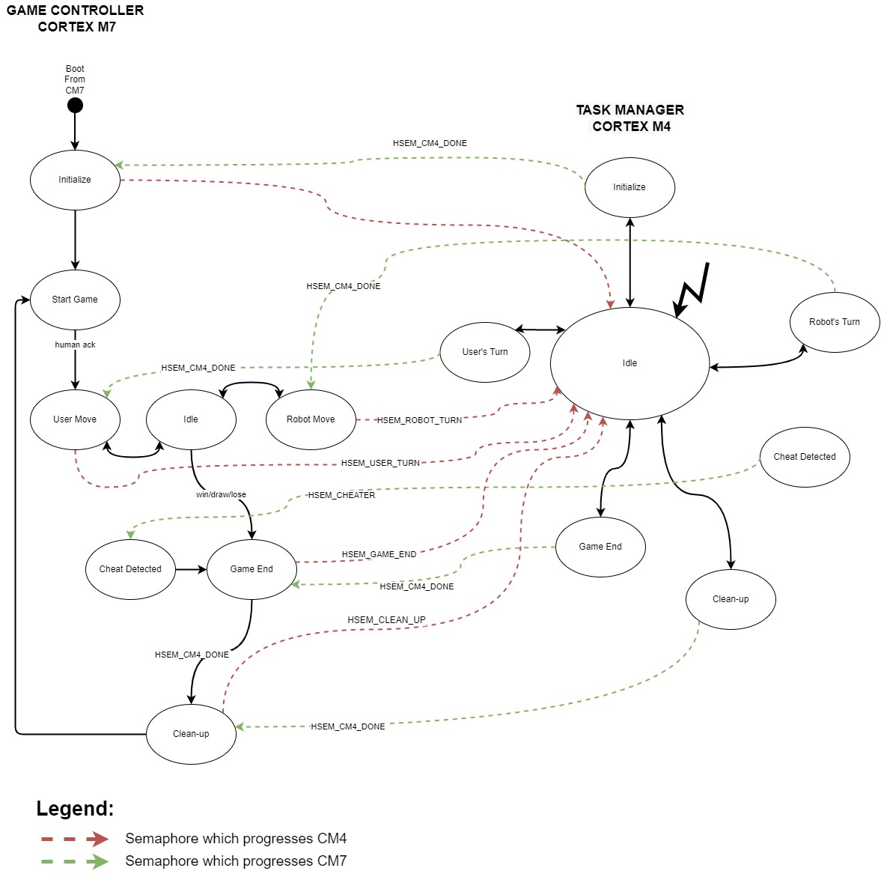
Notes:
The Semaphores in the code are used to signal to each core when it should transition states, in order to advance further. In any given core, we activate notifications for semaphores for which we would require a reaction when released. In the other core, we take and release the semaphore, to trigger the response in the first core. This response in our case is triggering a state transition, by giving it a "task". One semaphore is one task. By releasing a specific semaphore in a certain state, specific actions need to happen. By using the semaphores in such a way, we can make the two cores, synchronize their tasks and advance each other accordingly.

